Slide 1



X
FINAL TASK
Jubelio Quality Assurance
Batch September 2023
Presented by
Bambang Satrio Gandhi
“Dream, think, say, do, and consistens”

Slide 2


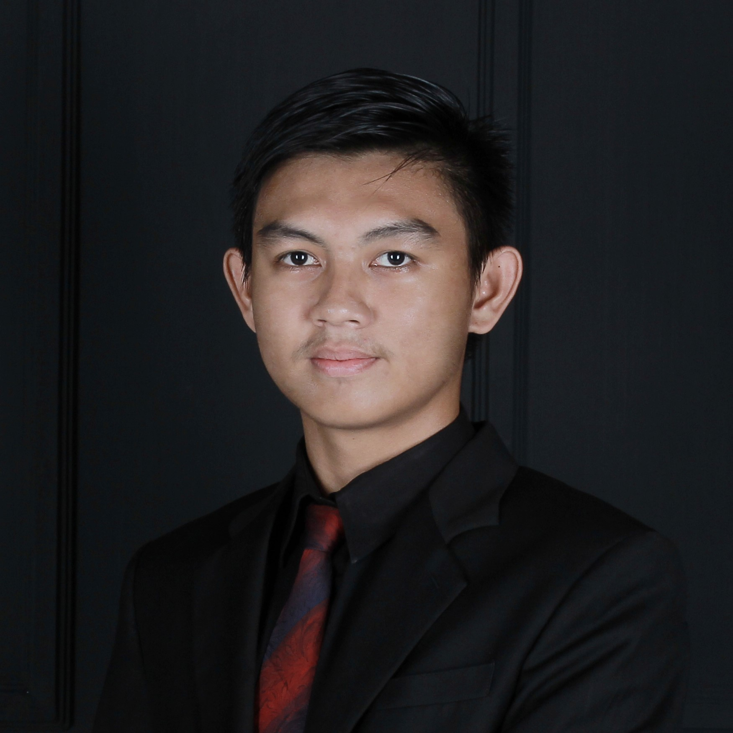
Bambang
Satrio
Gandhi
Insert Your Experience
IT Support
Rumah Sakit As-Syifa Bengkulu
2022-Now
Activites
-Bridging SIMRS Khanza with Antrean Online BPJS - Bridging SIMRS Khanza with Aplicare BPJS - Bridging SIMRS Khanza with Operation Schedule BPJS - Troubleshooting Software and Hardware
About You
I am sociable, able to complete my work on time, highly committed, and always learning new things. Routines are a reminder to always learn, make new things and value time.

Slide 3
Case Study
Buatlah test case pada beberapa ﬁtur di Jubelio:
User login Jubelio (Jubelio page) https://app.jubelio.com/login
User membuat negative test case pada login Jubelio (Jubelio page) https://app.jubelio.com/login
User membuat barang baru non varian pada katalog (Jubelio page)
Lakukan API testing dengan Postman pada Jubelio API:
1. Testing pada endpoint:
○ Login: Jubelio API
○ All product price: Jubelio API
○ Upload product image: Jubelio API
○ Delete product: Jubelio API
2. Lengkapi testing API dengan negative scenario (min 1 pada tiap test)
3. Buatlah test case terkait API test tersebut

Slide 4
Case Study
Buatlah Web Automation dengan Selenium Web Driver
1. Buat automation scenario pada Login ﬂow di halaman Jubelio
2. Buat automation scenario untuk mengatur stock persediaan
Buatlah Github repository untuk web automation yang telah Anda buat
Buat Github account
Buat Github repository
Upload local code ke remote repository
Berikan step by step untuk menjalankan automation yang telah dibuat di local (Maksudnya dibuat note panduan atau bukan ??)
Berikan evidence pendukung (screen record) saat menjalankan web automation tersebut di local
Berikan evidence (screenshot) run results (jumlah scenario dan jumlah steps) di local

Slide 5
TEST CASE
Check more details at my Notion
https://playful-slope-d9c.notion.site/Final-Task-Jubelio-Quality-Assurance-X-Rakamin-Academy-63456cf0f52b49cab74521de10bf1e5e?pvs=4
Jira Documetation
https://itsdandisatrio.atlassian.net/browse/JP-1?atlOrigin=eyJpIjoiZmQ4M2UyM2VmOWI0NDc2OGJkMjUzMmZhNmY5Y2E3YTEiLCJwIjoiaiJ9
https://itsdandisatrio.atlassian.net/browse/JP01-2?atlOrigin=eyJpIjoiMjQwZjYzY2UzYjg5NDhmODhjYjg3ODc2YjJkN2RmMDYiLCJwIjoiaiJ9

Slide 6
API TESTING
Check more details at my Notion
https://playful-slope-d9c.notion.site/Final-Task-Jubelio-Quality-Assurance-X-Rakamin-Academy-63456cf0f52b49cab74521de10bf1e5e?pvs=4
Documentation Postman
https://documenter.getpostman.com/view/17930985/2s9YJXaQjF

Slide 7
WEB AUTOMATION
Check more details at my Notion
https://playful-slope-d9c.notion.site/Final-Task-Jubelio-Quality-Assurance-X-Rakamin-Academy-63456cf0f52b49cab74521de10bf1e5e?pvs=4
Documentation GitHub
https://github.com/dandisatrio/vip_finaltask_jubelio_qa

Slide 8
Video Presentation
https://youtu.be/1WD8q86OskA?si=ShfeAb6Mi-iVQUoC

Slide 9
Thank You
X

